Slide 1
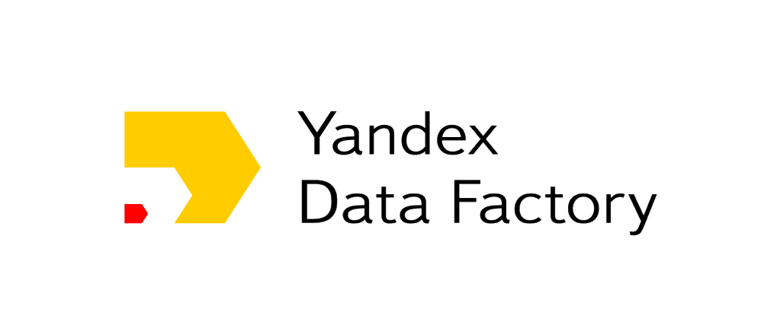
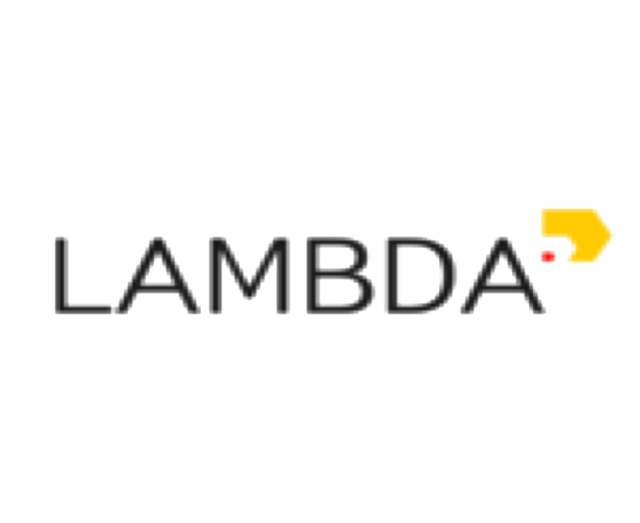
RL@Coursera week 3 Model-free reinforcement learning

Slide 2
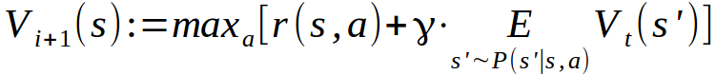
What we learned
V(s) and Q(s,a)
If we know V or Q → we have optimal policy
We can learn them with dynamic programming

Slide 3

Decision process in the wild
Agent
Can do anything
observation
action
Can't even see
(worst case)
Environment

Slide 4
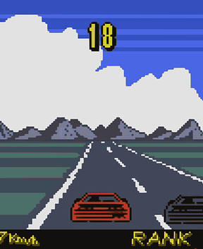
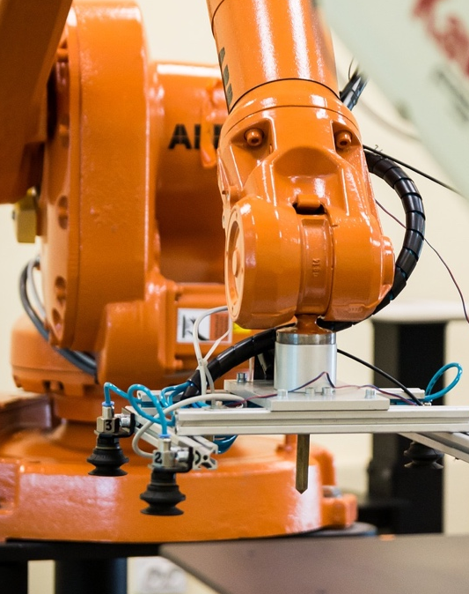
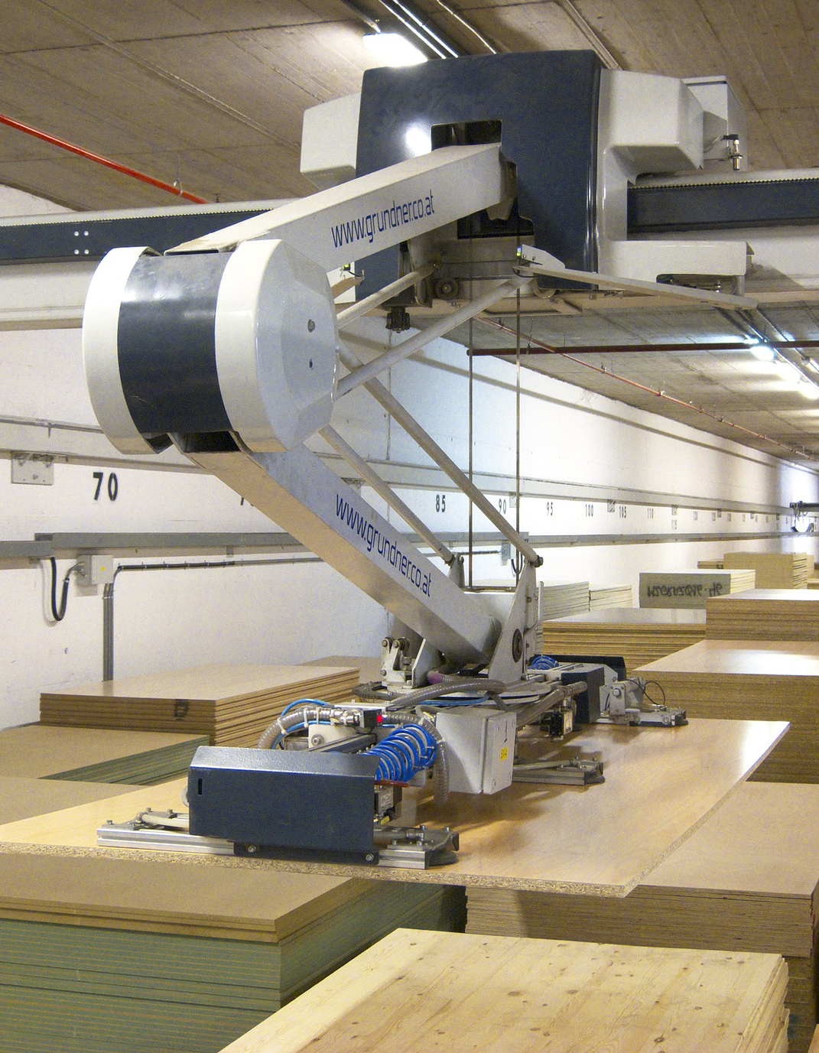
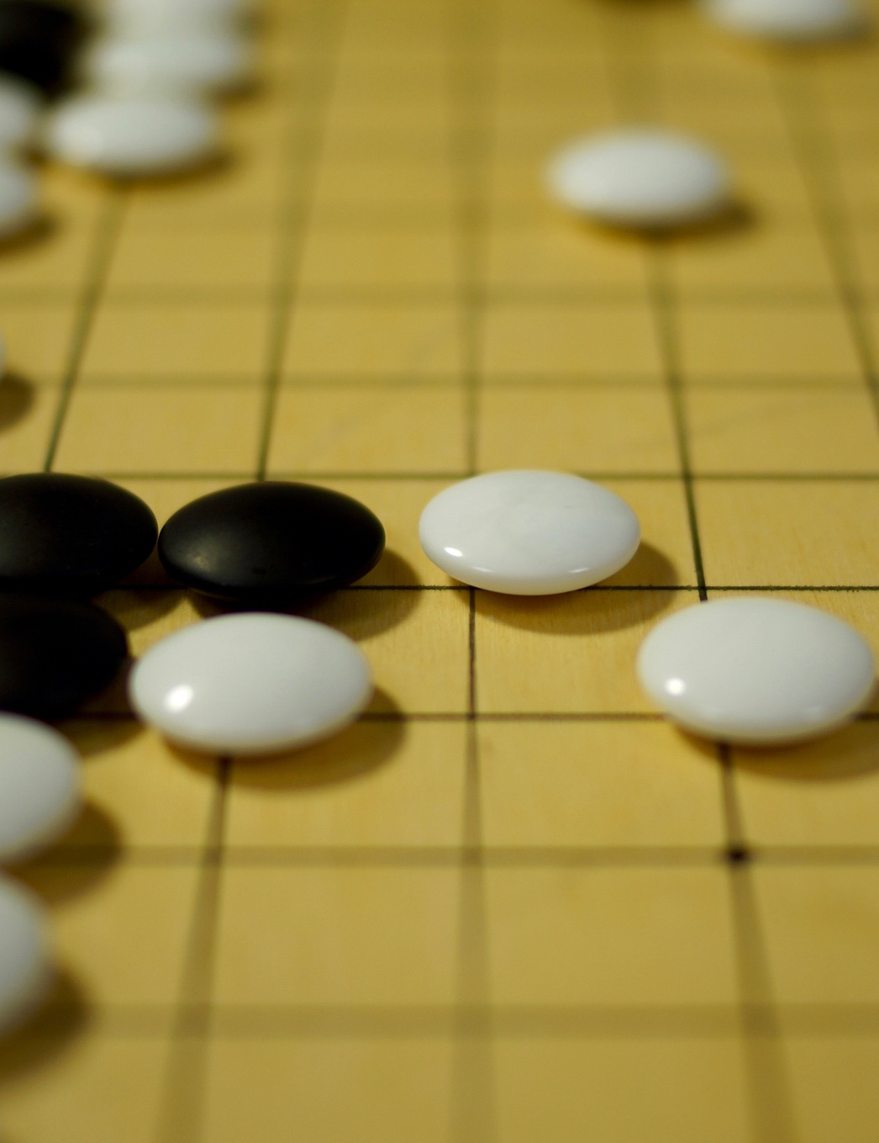
Decision process in the wild
Agent
Can do anything
vation
tion

Slide 5
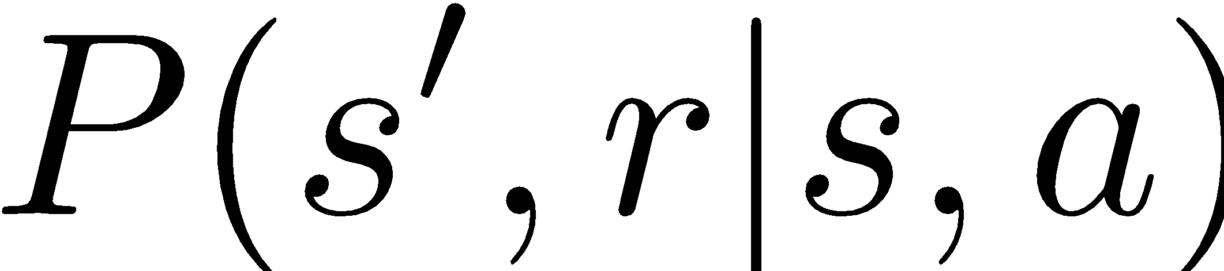
Model-free setting:
We don't know actual
Whachagonnado?

Slide 6
Model-free setting:
We don't know actual
Learn it?
Get rid of it?

Slide 7
What we learned
V(s) and Q(s,a)
If we know V or Q → we have optimal policy
We can learn them with dynamic programming
Can't enumerate all

Slide 8



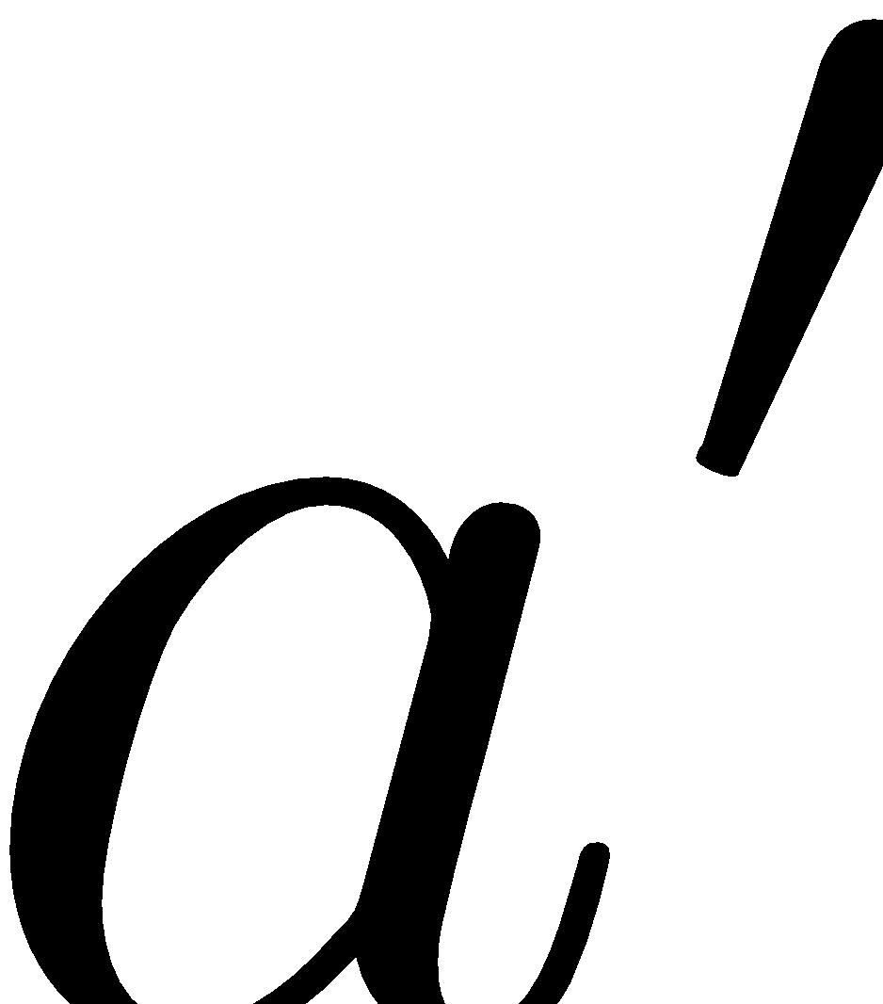
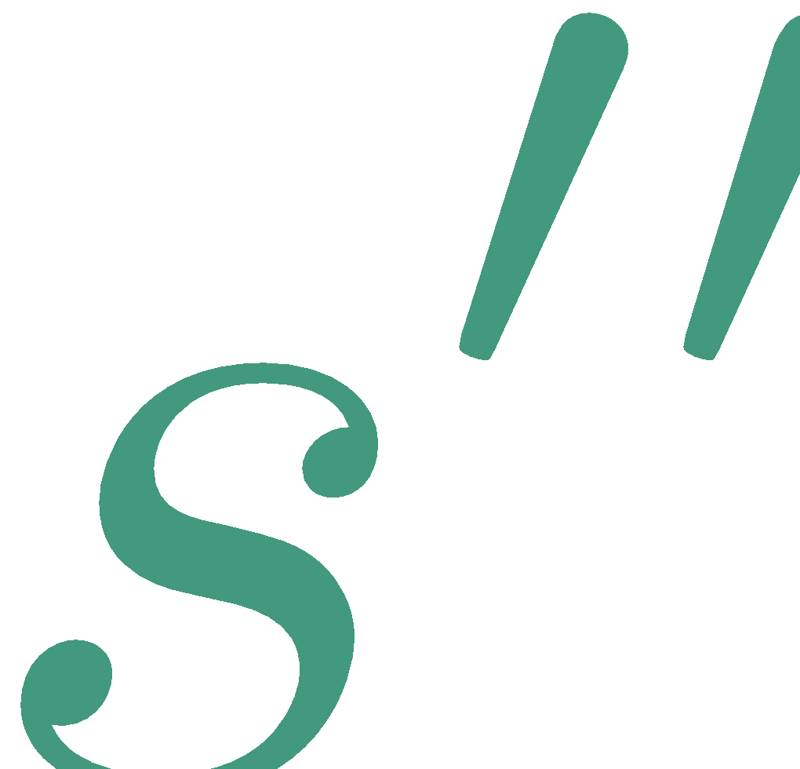

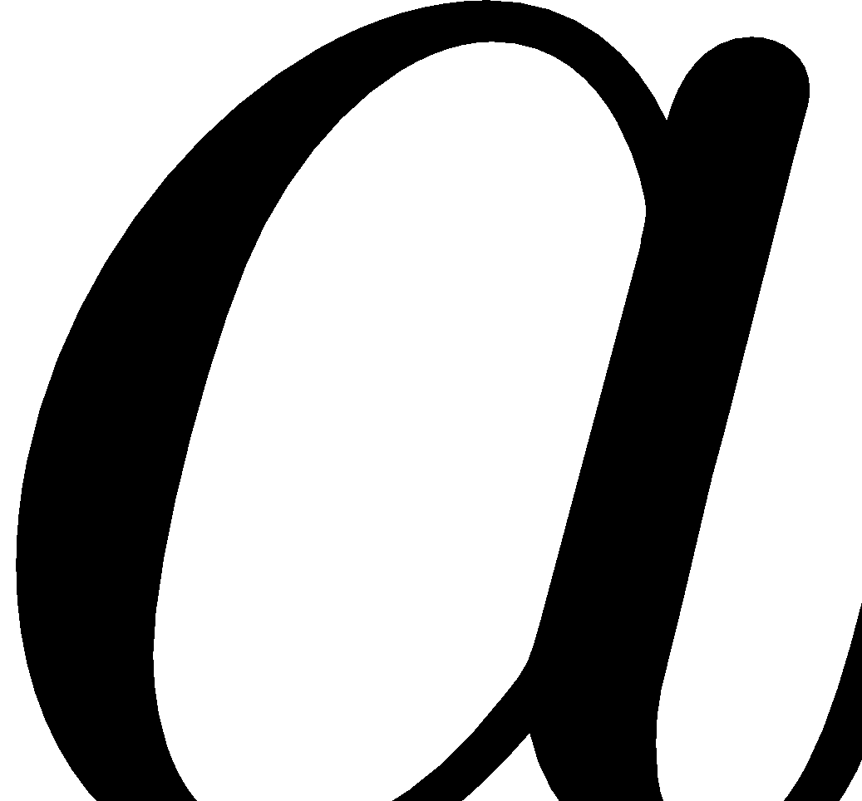
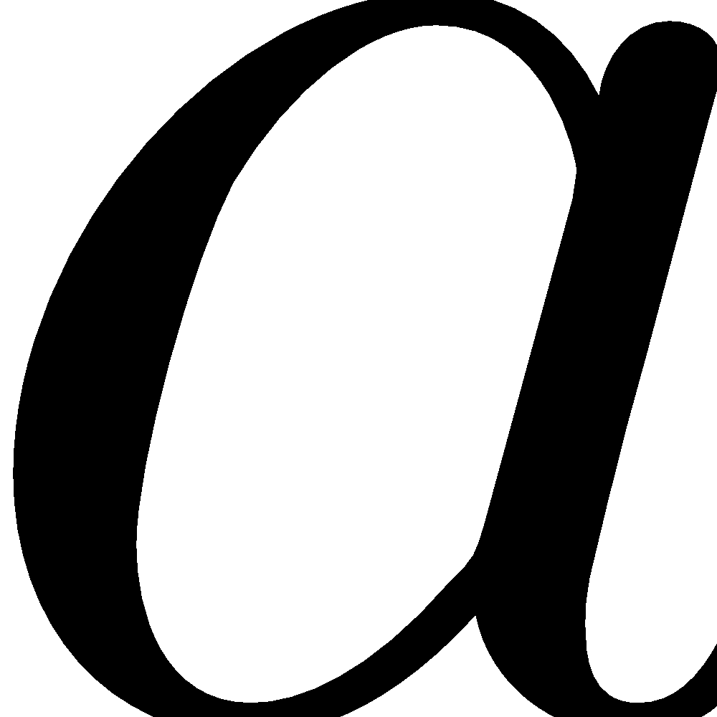
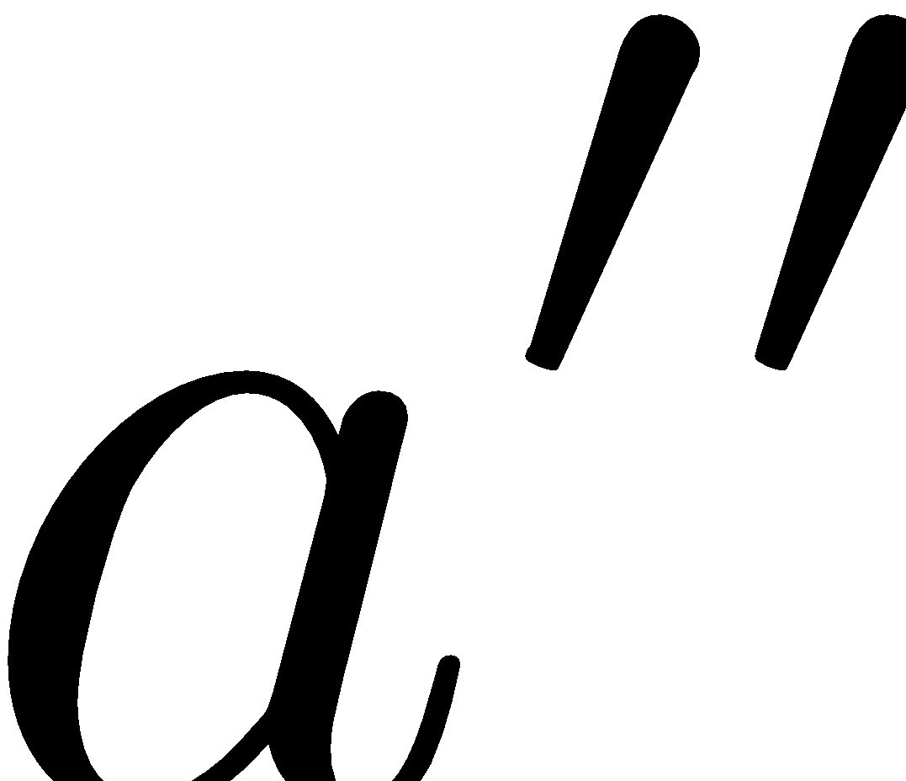
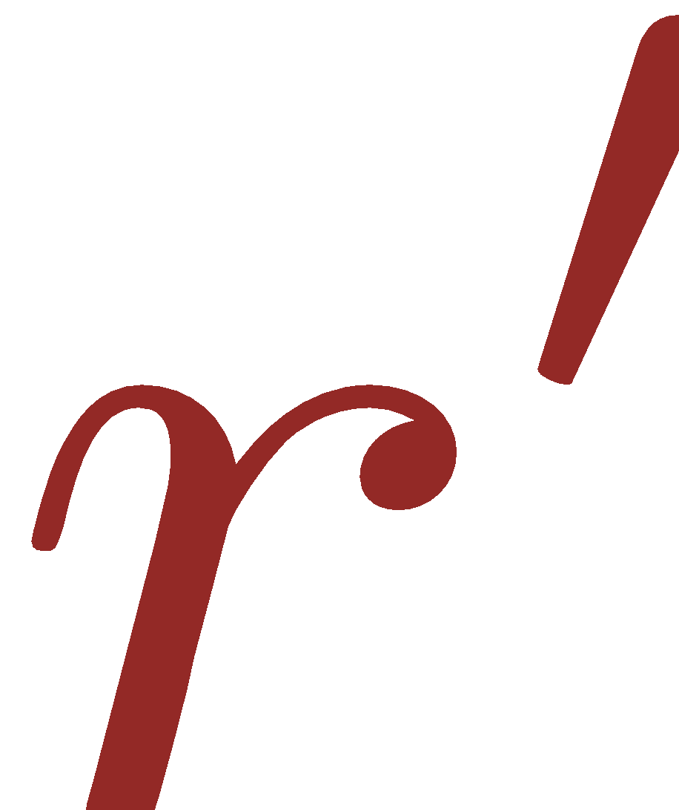
MDP trajectory
prev
prev

Slide 9
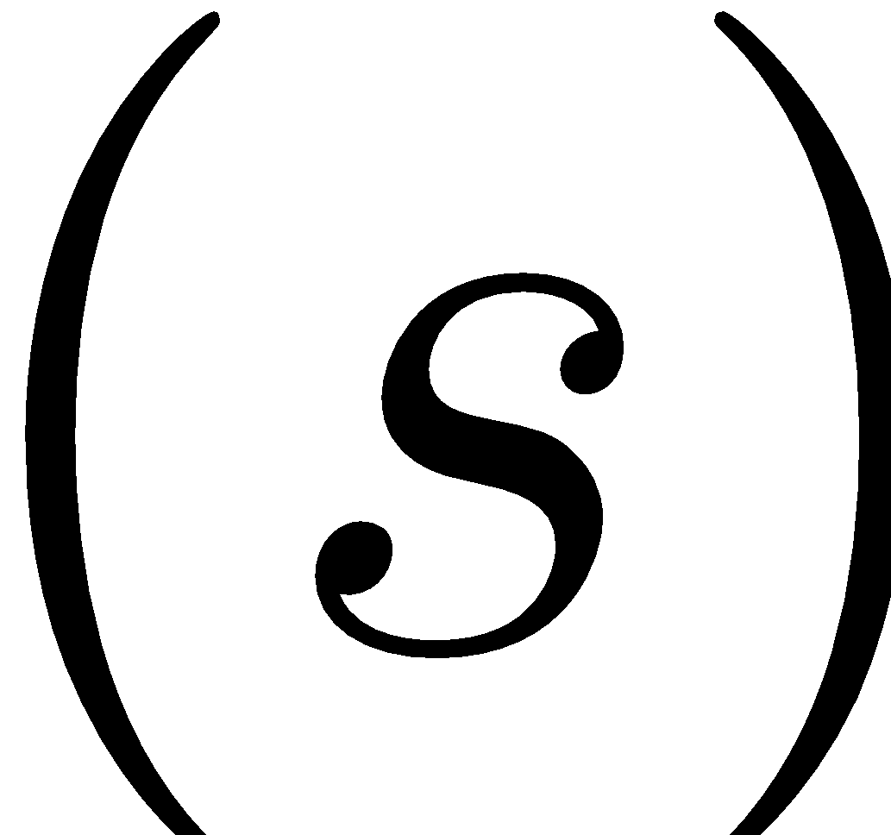
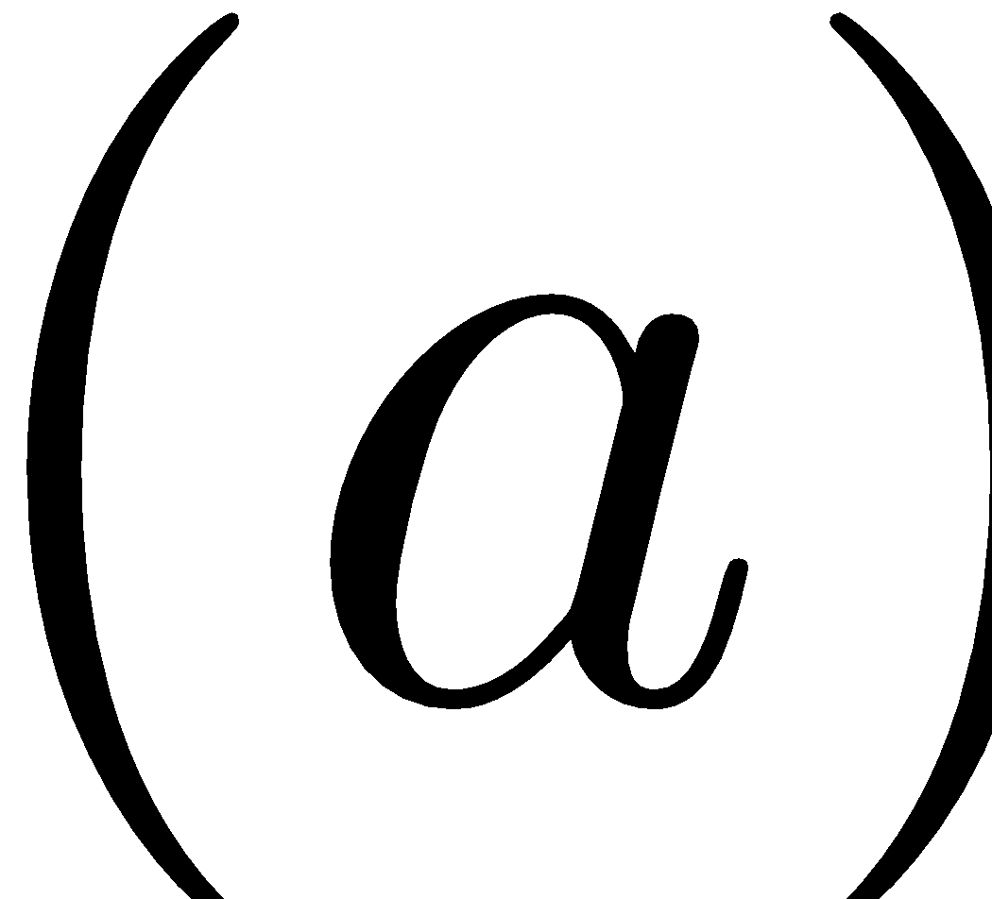
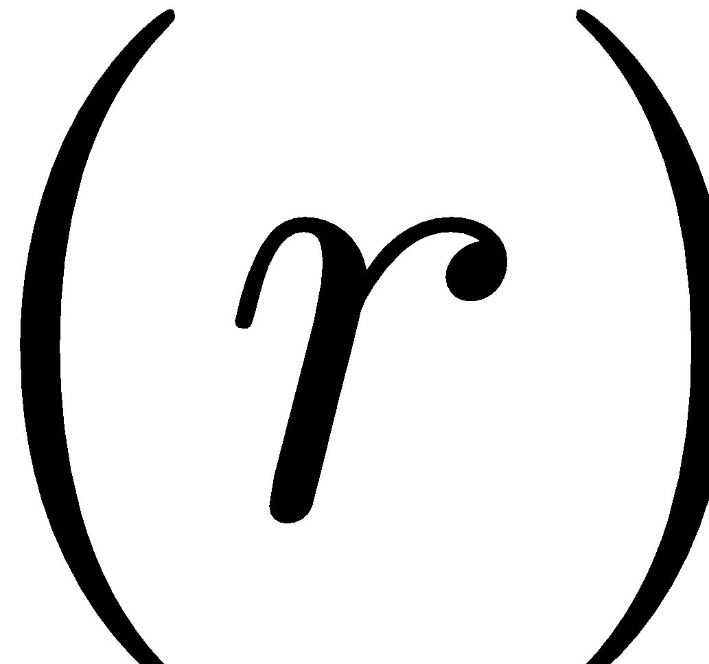
MDP trajectory
prev
prev
Trajectory is a sequence of
states
actions
rewards
We can only sample trajectories

Slide 10
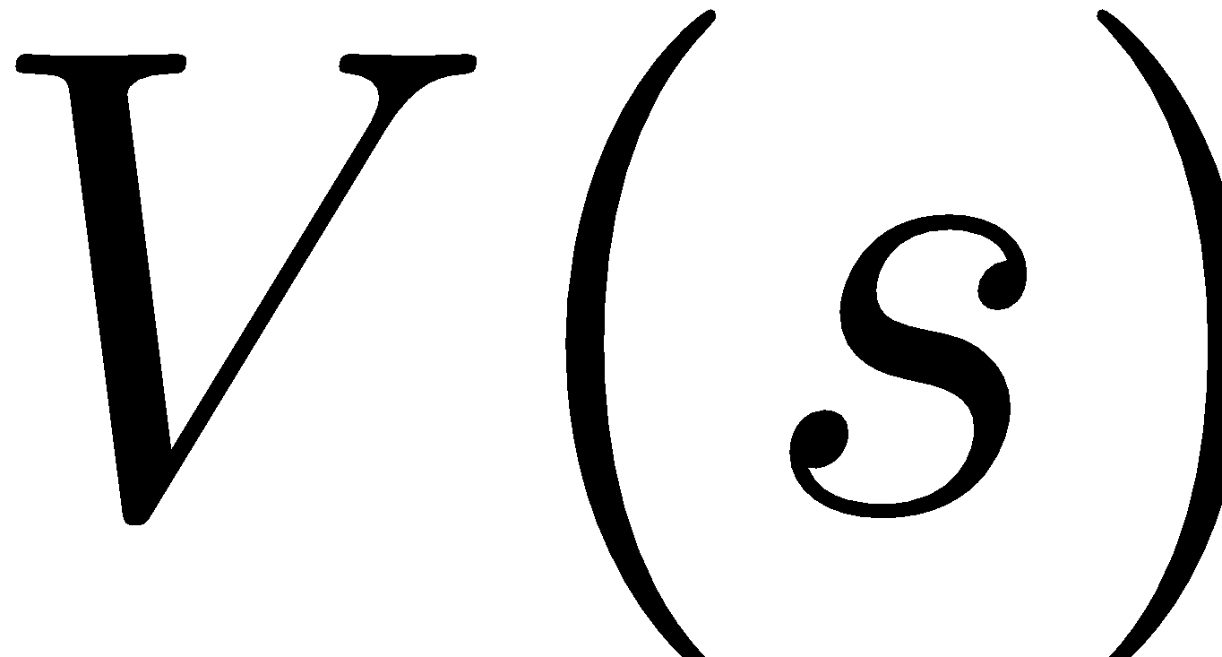
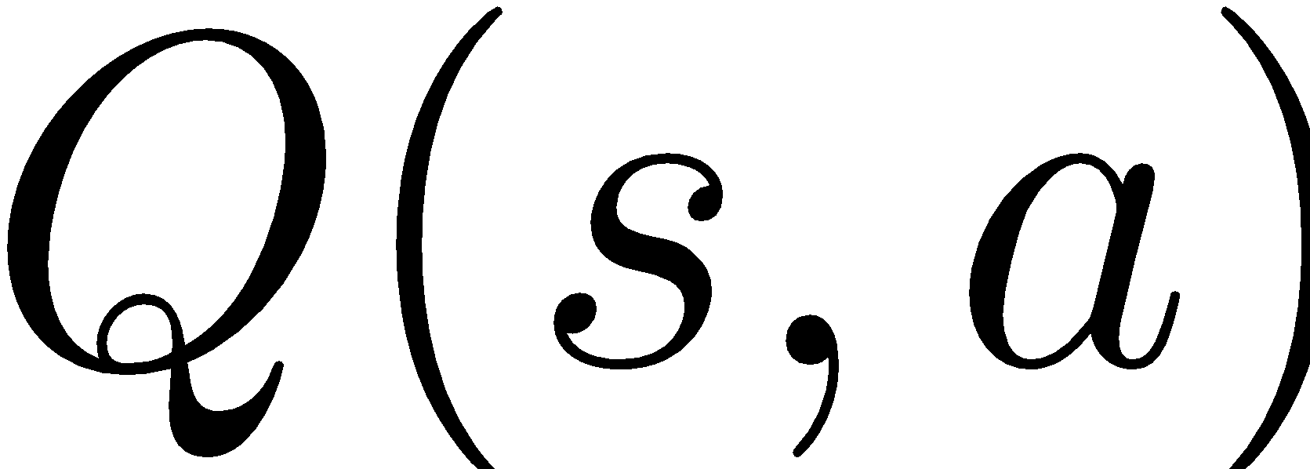
MDP trajectory
prev
prev
Trajectory is a sequence of
states
actions
rewards
We can only sample trajectories
Q: What to learn? or

Slide 11
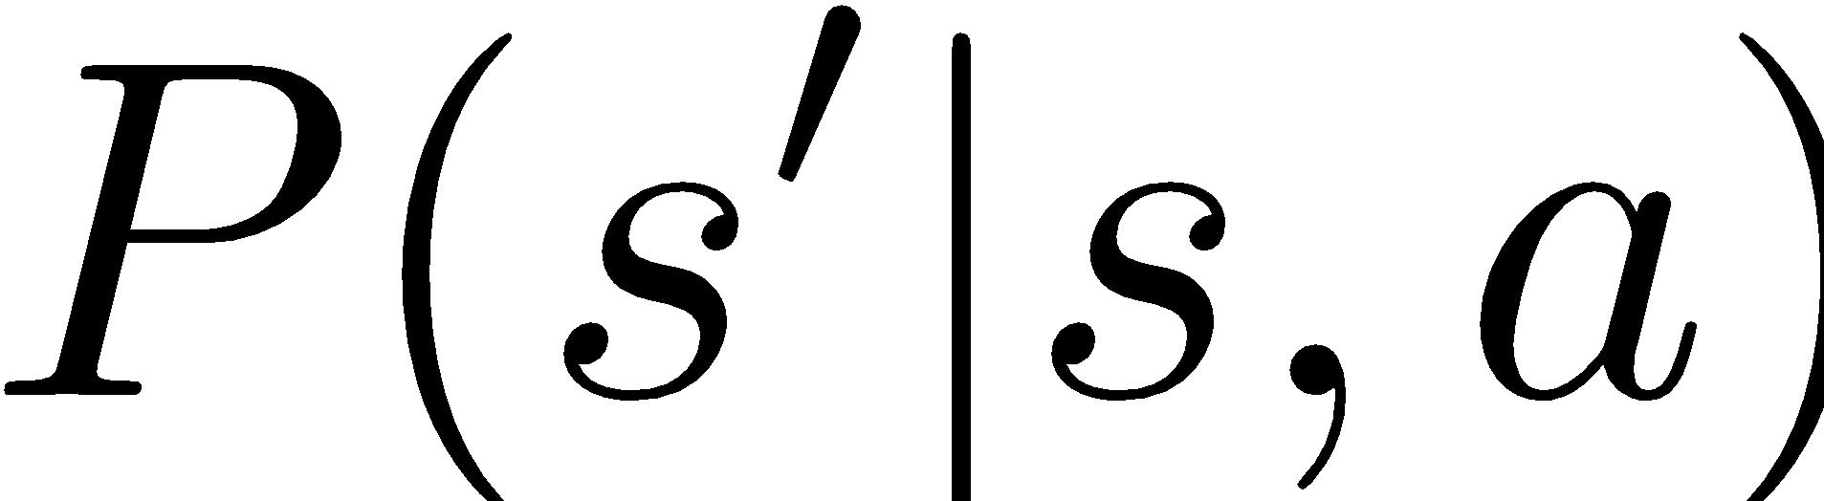
MDP trajectory
prev
prev
Trajectory is a sequence of
states
actions
rewards
We can only sample trajectories
is useless
without
Q: What to learn? or

Slide 12
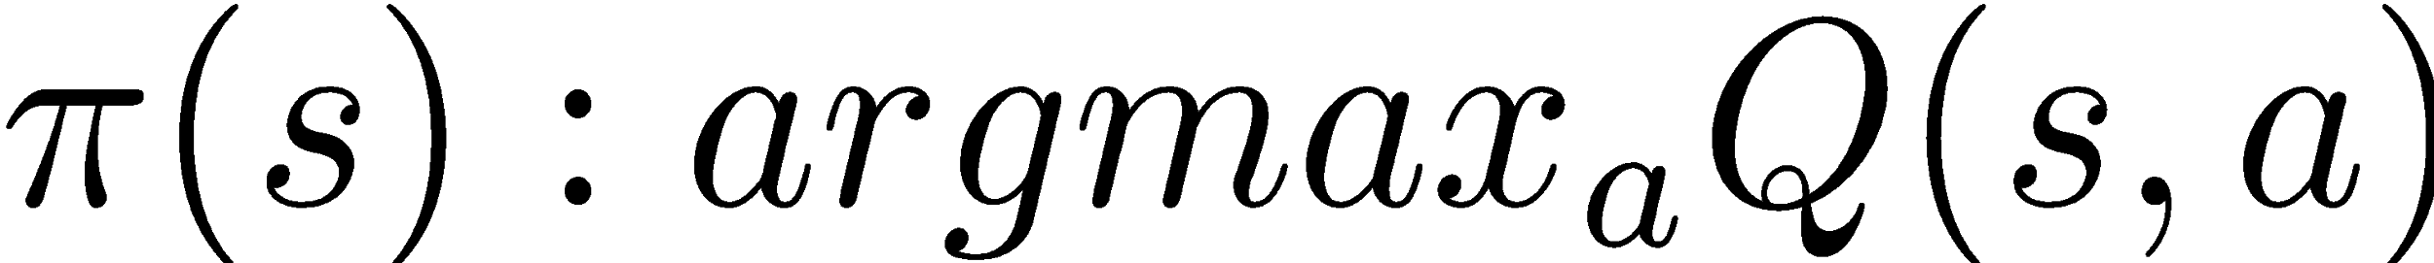
From V to Q
One approach: action Q-values
Action value Q(s,a) is the expected total reward G agent gets from state s by taking action a and following policy π from next state.

Slide 13
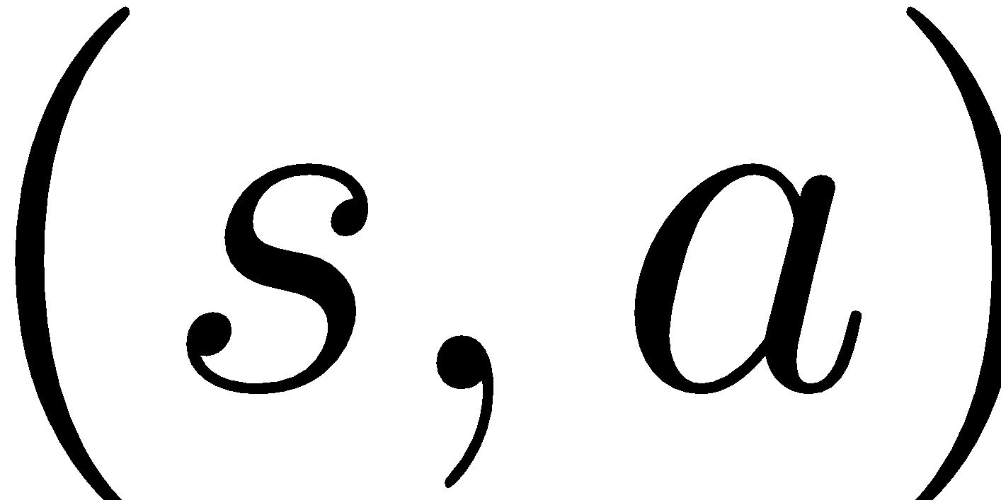
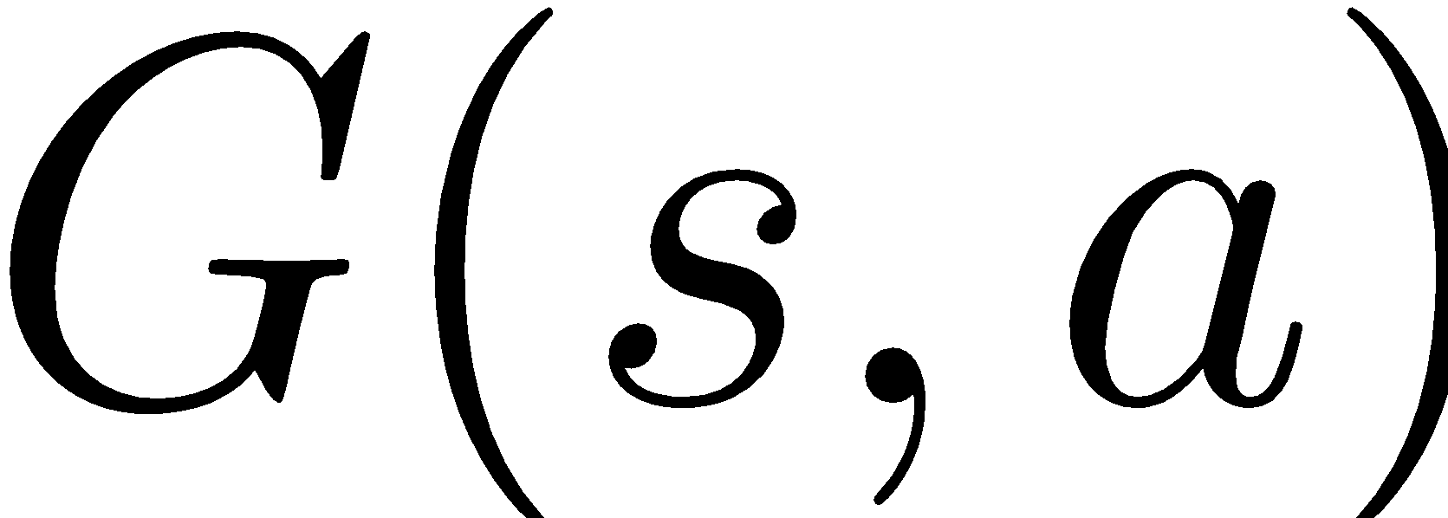
Idea 1: monte-carlo
Get all trajectories containing particular
Estimate for each trajectory
Average them to get expectation
+1
Cake!

Slide 14
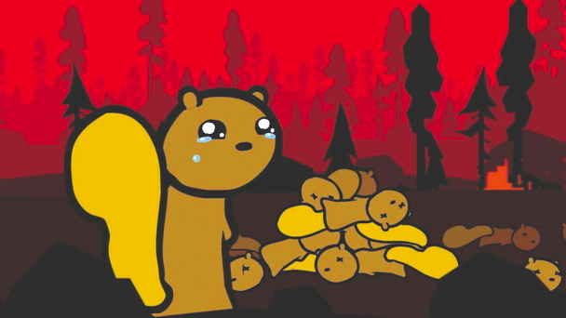
Idea 1: monte-carlo
Get all trajectories containing particular
Estimate for each trajectory
Average them to get expectation
takes a lot of sessions
Авторство

Slide 15
Idea 1: temporal difference
Remember we can improve iteratively!

Slide 16
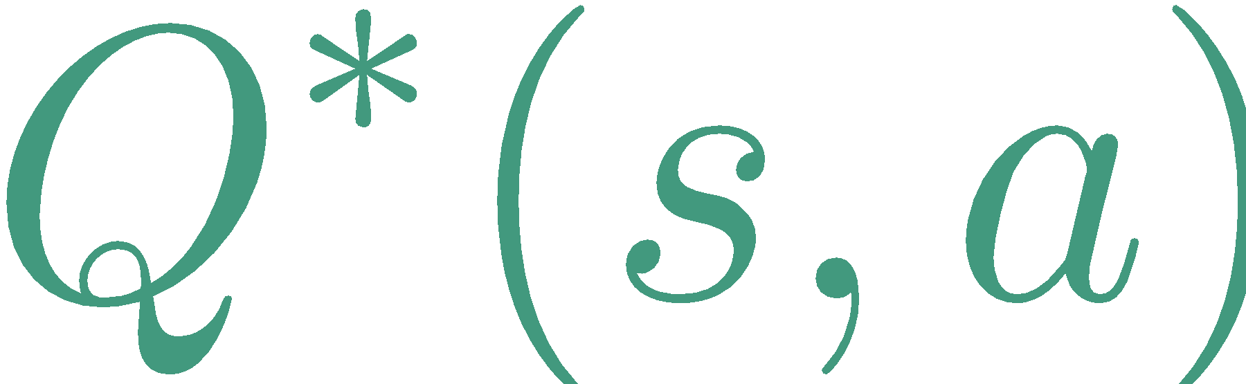
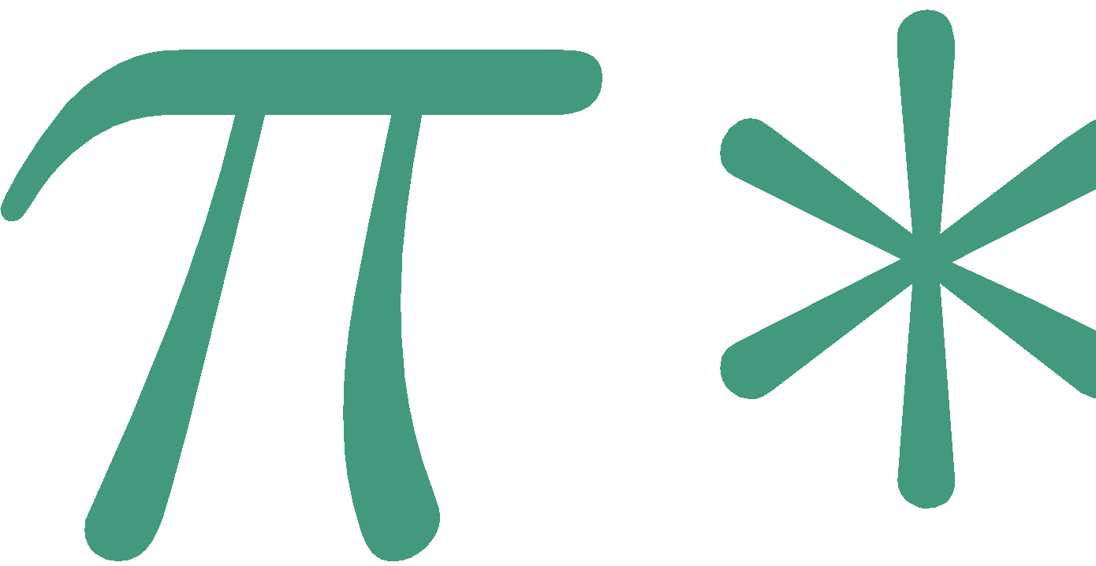
Idea 1: temporal difference
Remember we can improve iteratively!
That’s
That's value for
aka optimal policy

Slide 17
Idea 1: temporal difference
Remember we can improve iteratively!
That’s
That's value for
aka optimal policy
That's something
we don't have
What do we do?

Slide 18
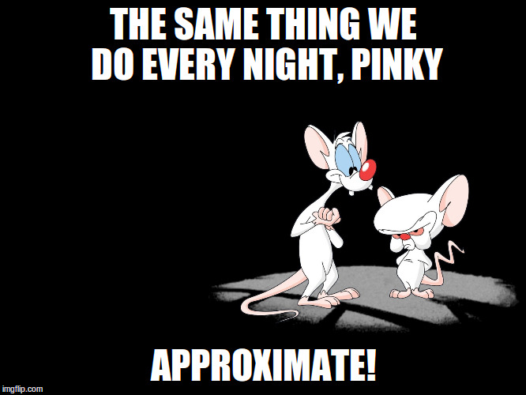
Idea 1: temporal difference
Авторство

Slide 19
Idea 1: temporal difference
Replace expectation with sampling

Slide 20
Idea 1: temporal difference
Replace expectation with sampling
Use moving average with just one sample!

Slide 21
MDP trajectory
prev
prev
Trajectory is a sequence of
states
actions
rewards

Slide 22

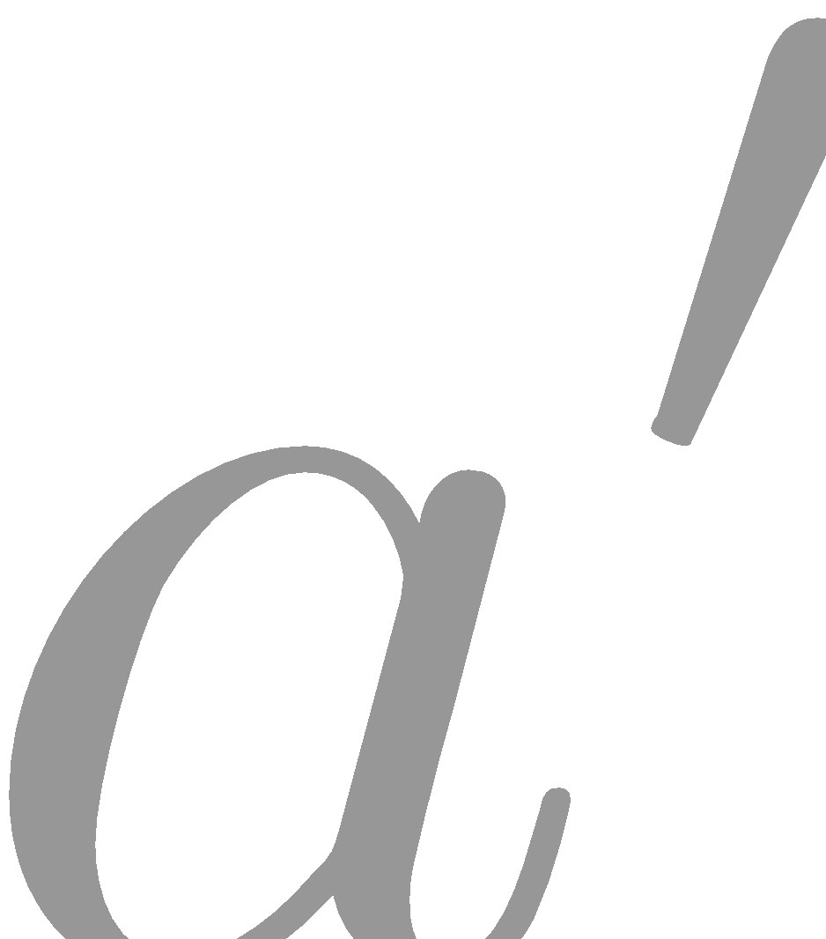
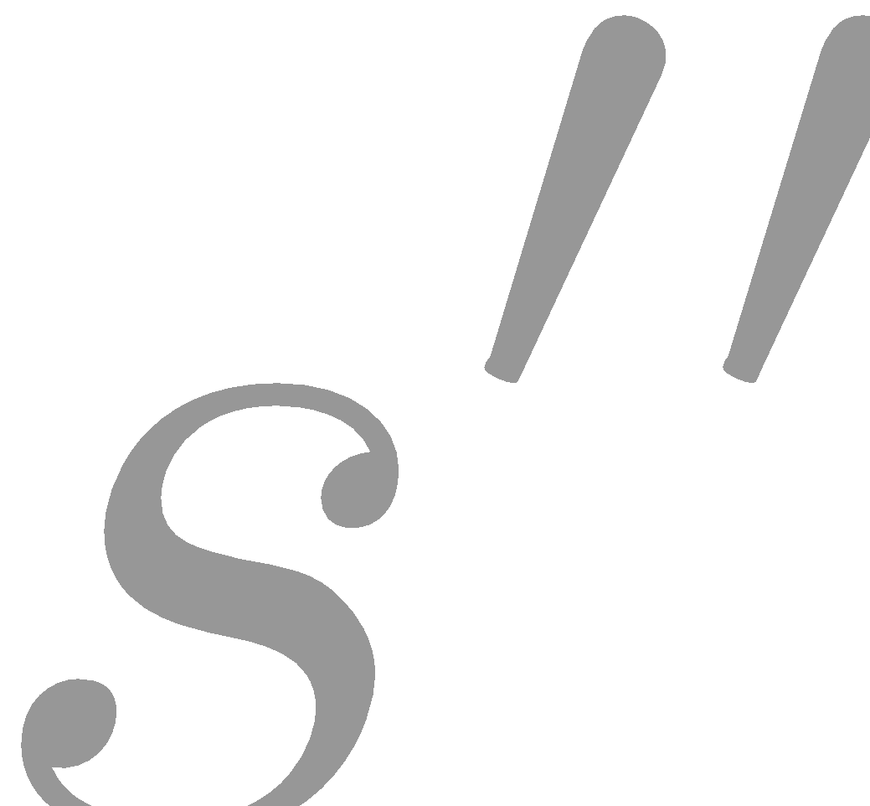

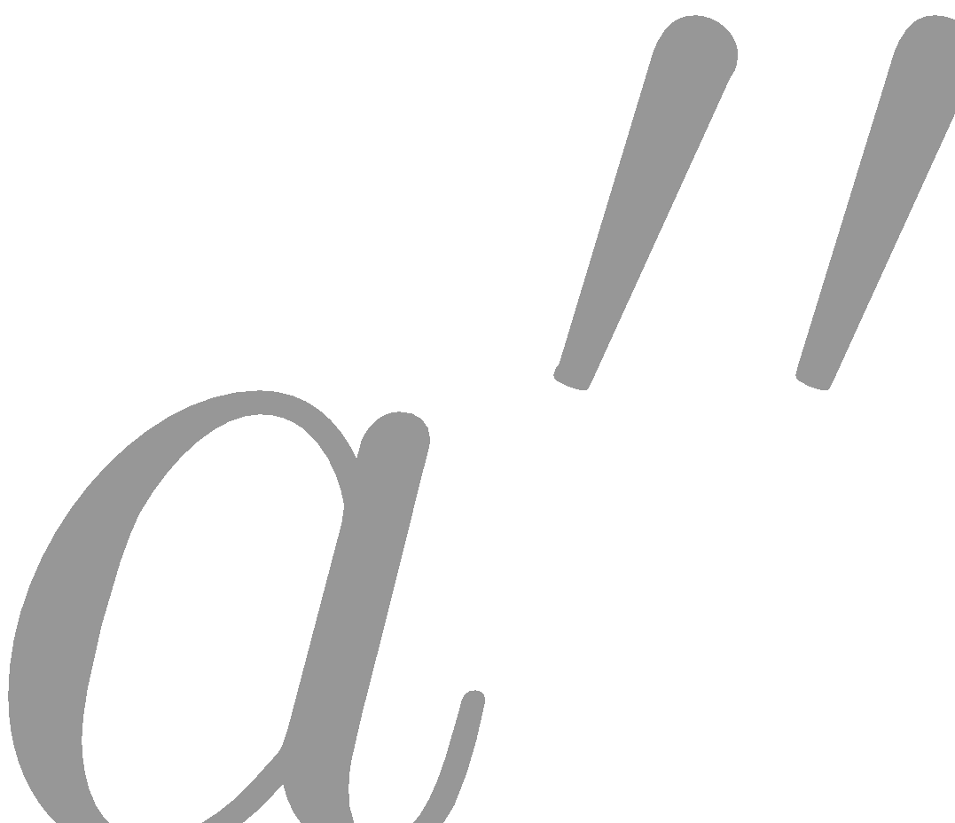
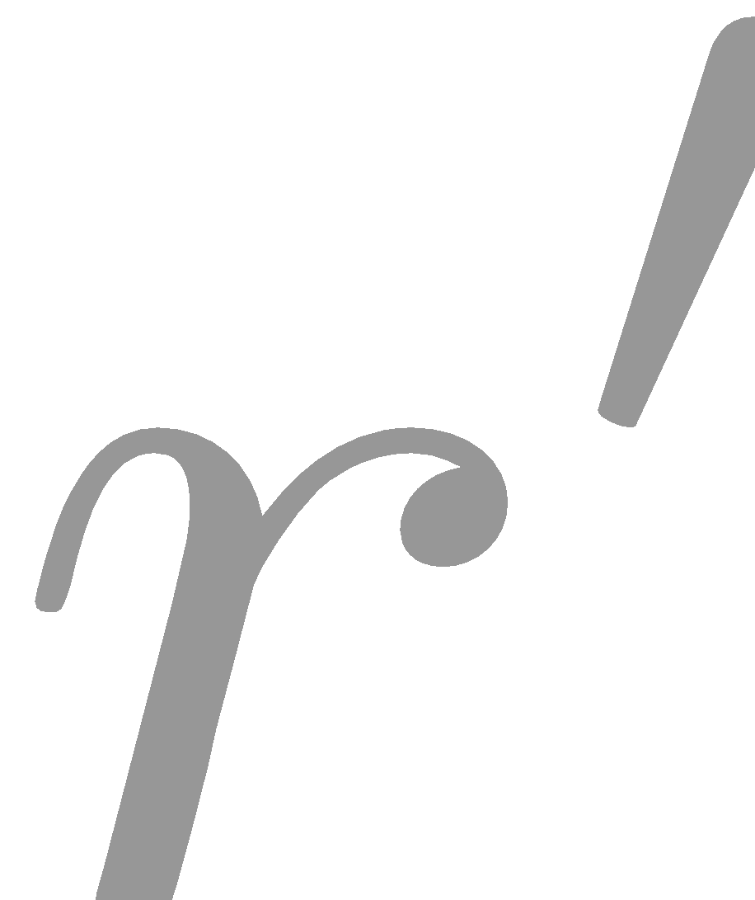
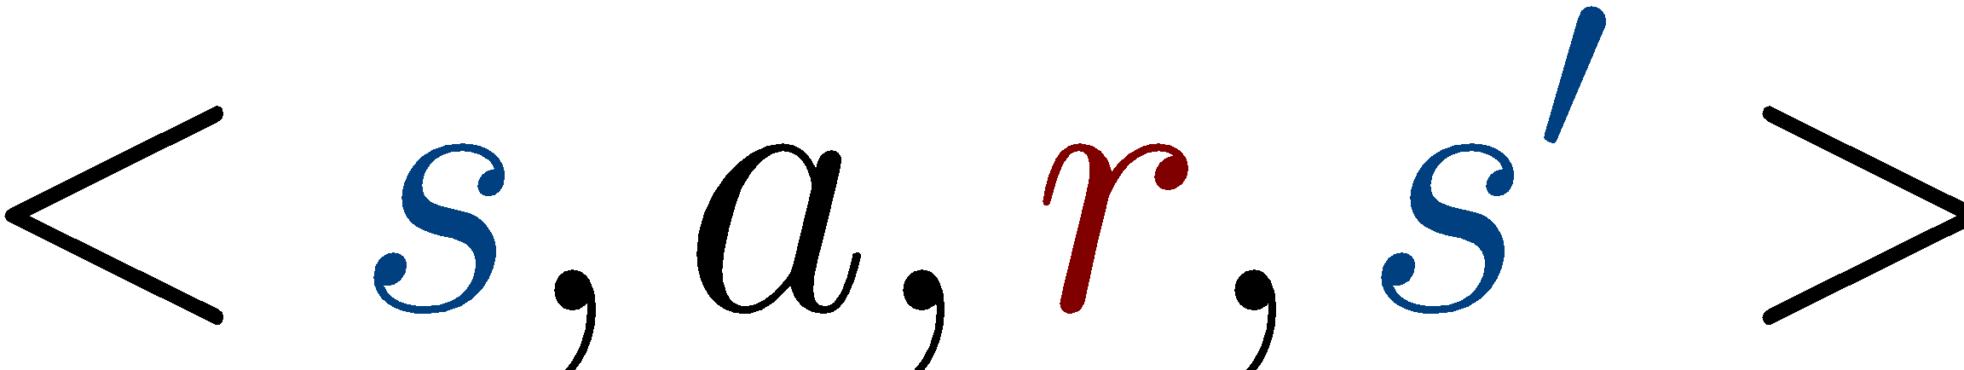
Q-learning
prev
prev
Initialize Q(s,a) with zeros
Loop:
Sample from env

Slide 23
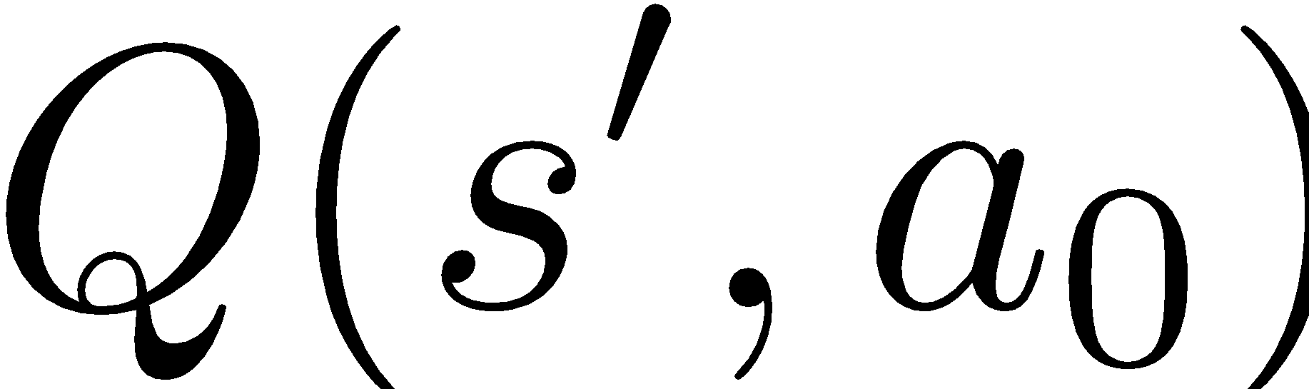
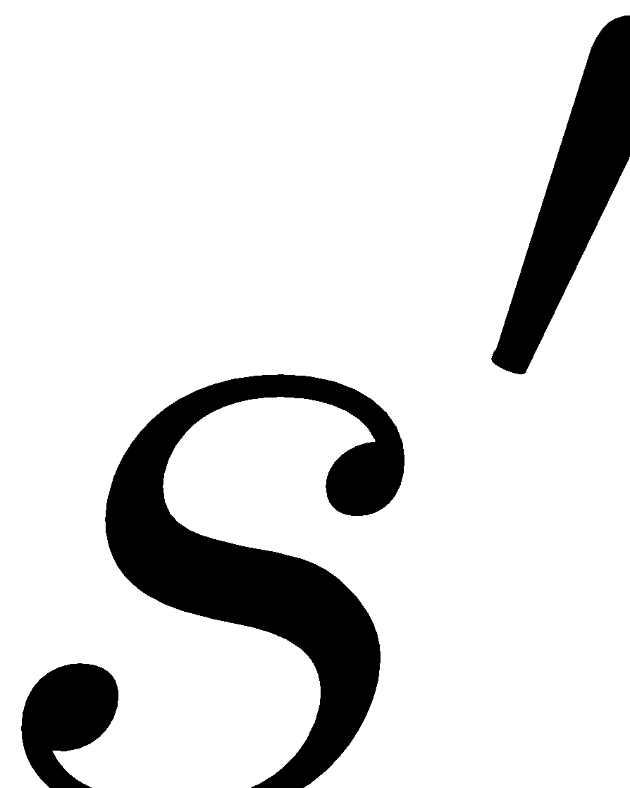
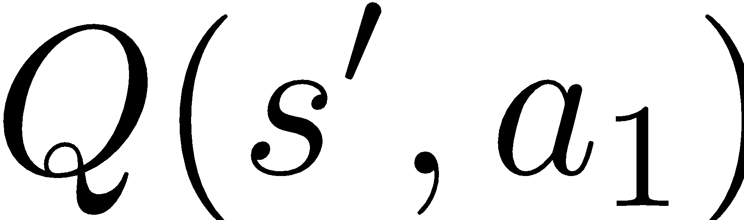

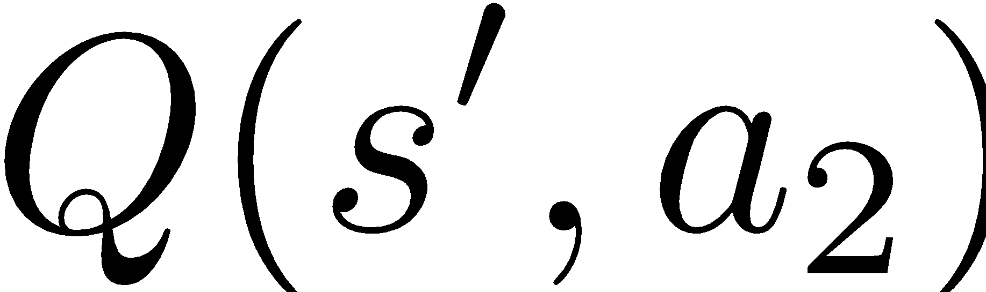
Q-learning
prev
prev
possible actions
Initialize Q(s,a) with zeros
Loop:
Sample from env
Compute

Slide 24
Q-learning
prev
prev
possible actions
Initialize Q(s,a) with zeros
Loop:
Sample from env
Compute
Update

Slide 25
Recap
Monte-carlo | Temporal Difference
Averages Q over sampled paths | Uses recurrent formula for Q
+1
Cake!

Slide 26
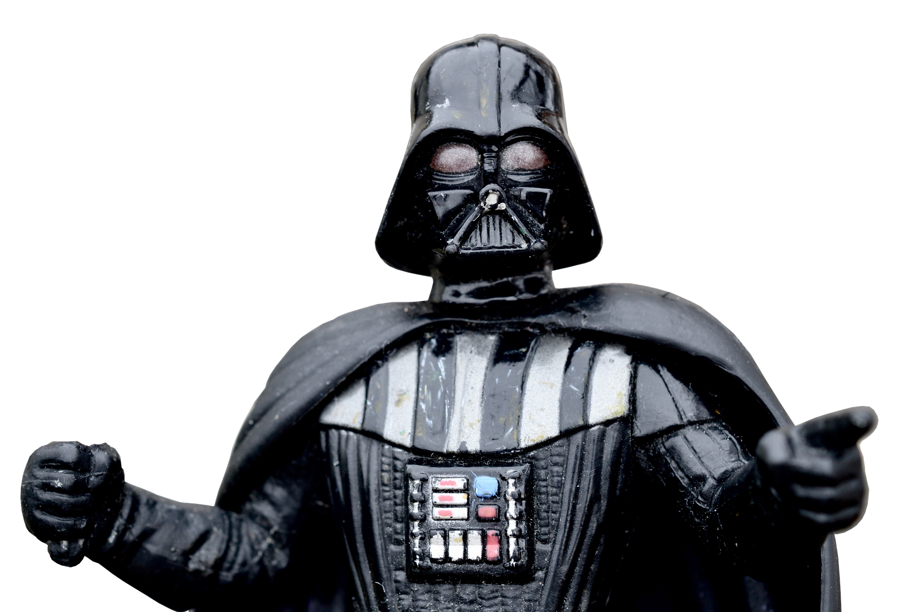
Nuts and bolts: MC vs TD
Monte-carlo | Temporal Difference
Averages Q over sampled paths | Uses recurrent formula for Q
Needs full trajectory to learn | Learns from partial trajectory Works with infinite MDP
Less reliant on markov property | Needs less experience to learn

Slide 27
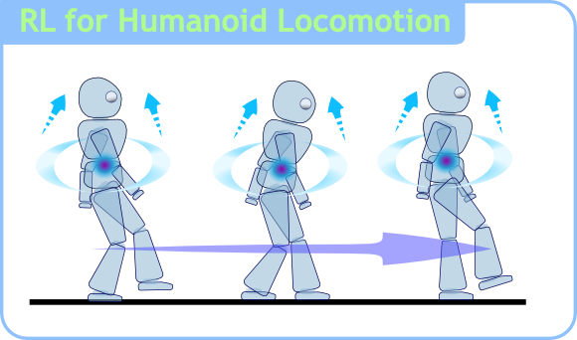
What could possibly go wrong?
Our mobile robot learns to walk.
Initial are zeros
robot uses argmax
He has just learned to crawl with positive reward!
Авторство

Slide 28
What could possibly go wrong?
Our mobile robot learns to walk.
Initial are zeros
robot uses argmax
Too bad, now he will never learn to walk upright =(
Авторство

Slide 29
What could possibly go wrong?
New problem:
If our agent always takes “best” actions
from his current point of view,
How will he ever learn that other actions
may be better than his current best one?
Ideas?

Slide 30
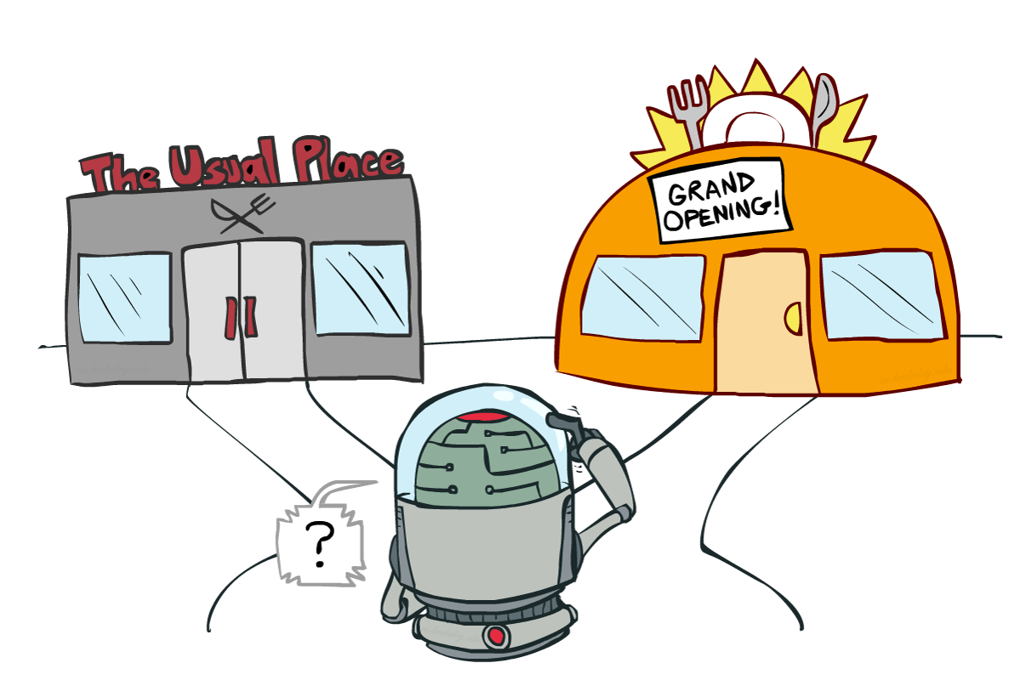
Exploration Vs Exploitation
Balance between using what you learned and trying to find something even better
Авторство

Slide 31
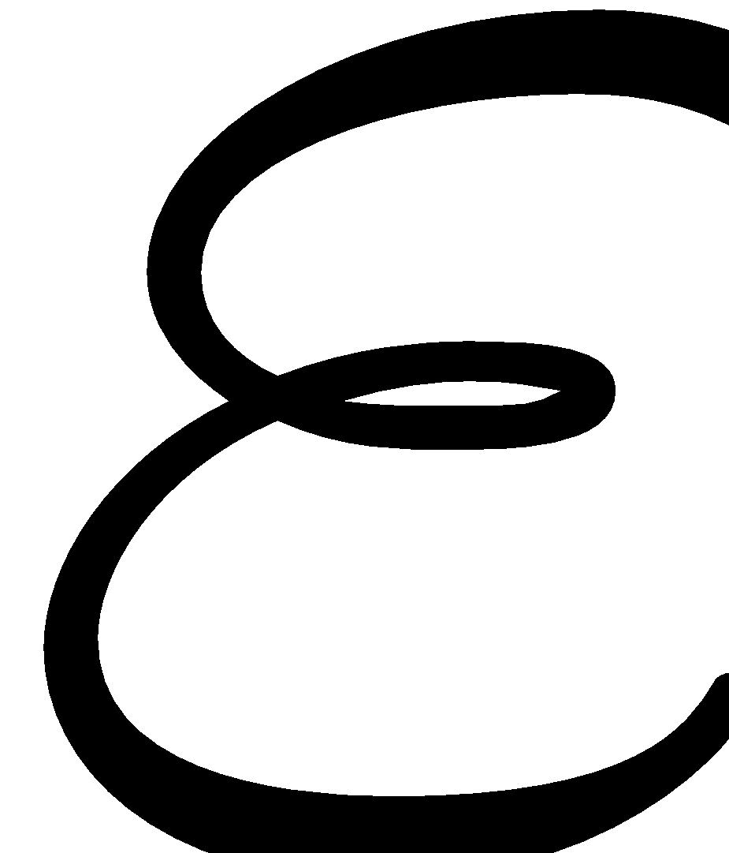
Exploration Vs Exploitation
Strategies:
- greedy
With probability take random action; otherwise take optimal action.

Slide 32
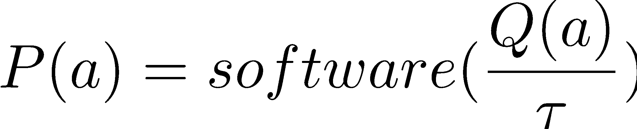
Exploration Vs Exploitation
Strategies:
- greedy
With probability take random action; otherwise take optimal action.
Softmax
Pick action proportional to softmax of shifted normalized Q-values.
More cool stuff coming later

Slide 33
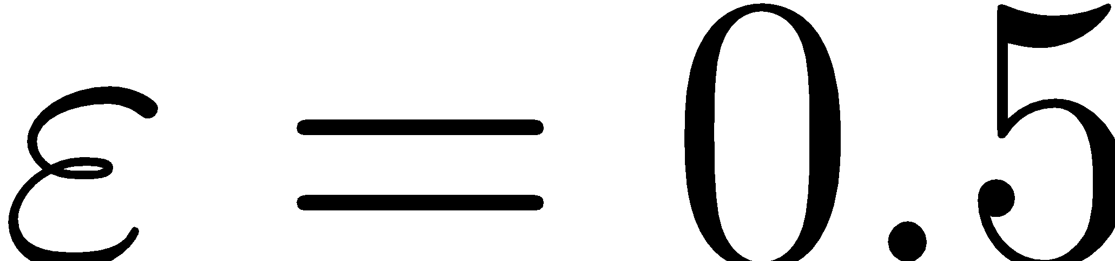
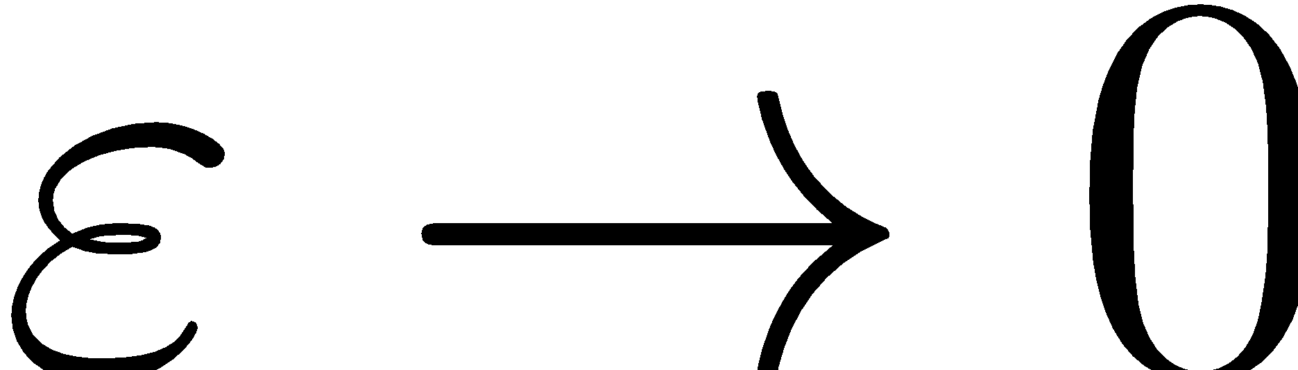
Exploration over time
Idea:
If you want to converge to optimal policy, you need to gradually reduce exploration
Example:
Initialize - greedy , then gradually reduce it
If , it's greedy in the limit
Be careful with non-stationary environments

Slide 34
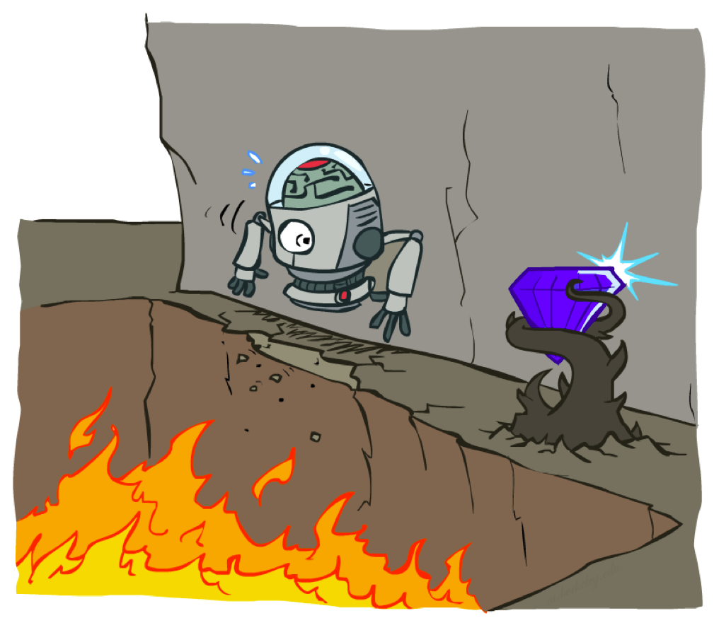
Cliff world
Picture from Berkeley CS188x

Slide 35
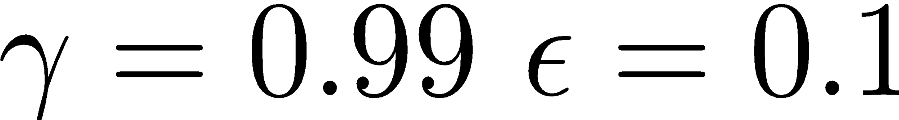
Cliff world
 |  |  |  | 10.00
-10.00 | -10.00 | -10.00 | -10.00 | -10.00
Conditions
Q-learning
no slipping
Trivia: What will q-learning learn?

Slide 36
Cliff world
 |  |  |  | 10.00
-10.00 | -10.00 | -10.00 | -10.00 | -10.00
Conditions
Q-learning
no slipping
Trivia: What will q-learning learn?
Will it maximize reward?
follow the short path

Slide 37
Cliff world
 |  |  |  | 10.00
-10.00 | -10.00 | -10.00 | -10.00 | -10.00
Conditions
Q-learning
no slipping
Trivia: What will q-learning learn?
Will it maximize reward?
follow the short path
no, robot will fall due to epsilon-greedy “exploration”

Slide 38

Cliff world
 |  |  |  | 10.00
-10.00 | -10.00 | -10.00 | -10.00 | -10.00
Conditions
Q-learning
no slipping
Decisions must account
for actual policy!
e.g. - greedy policy

Slide 39
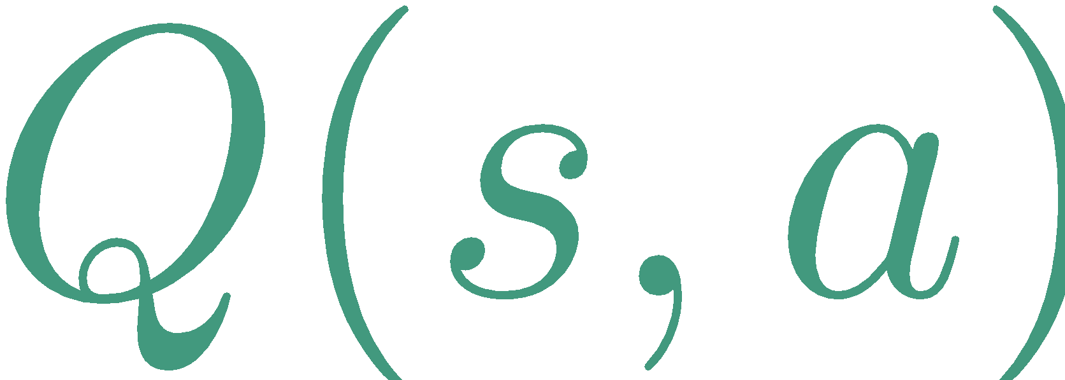
Generalized update rule
Update rule (from Bellman eq.)
“better “

Slide 40
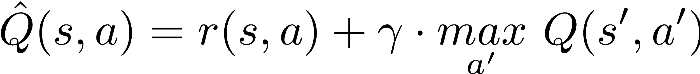
Q-learning VS SARSA
Update rule (from Bellman eq.)
Q-learning
“better “

Slide 41
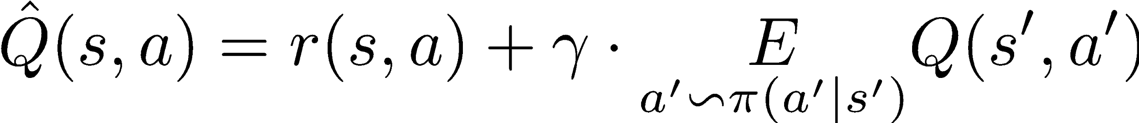
Exploration over time
Update rule (from Bellman eq.)
Q-learning
SARSA
“better “

Slide 42
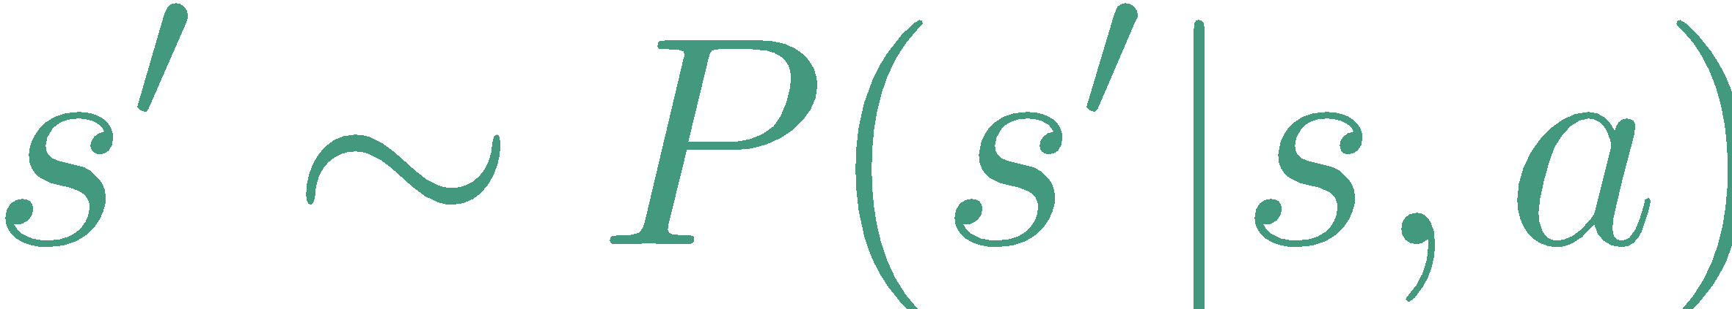
Exploration over time
Update rule (from Bellman eq.)
Q-learning
SARSA
“better “
Expected from

Slide 43
MDP trajectory
prev
prev
Trajectory is a sequence of
states
actions
rewards
Can be infinite, we can't wait that long

Slide 44
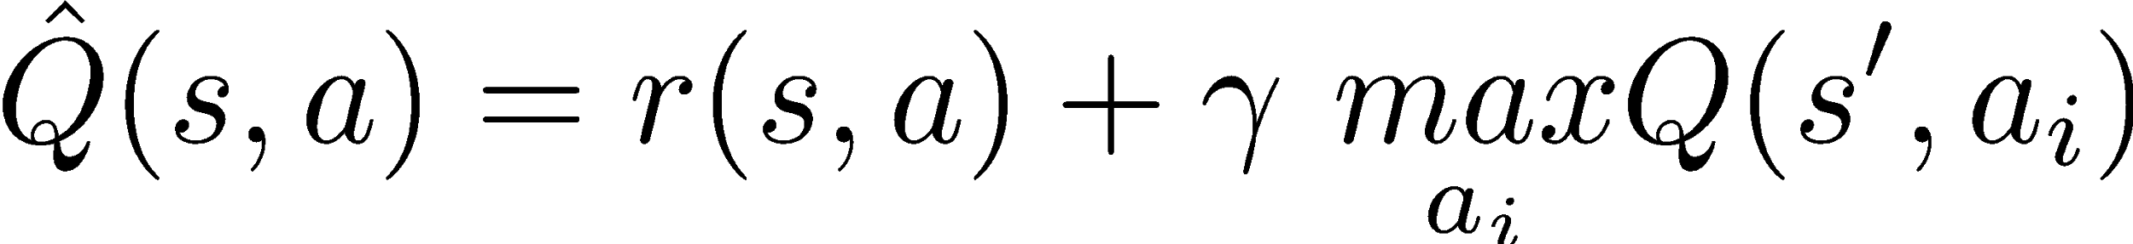
Recap: Q-learning
possible actions
prev
prev
Initialize Q(s,a) with zeros
Loop:
Sample from env
Compute
Update

Slide 45


SARSA
prev
prev
Initialize Q(s,a) with zeros
Loop:
Sample ‘ from env
Compute
Update

Slide 46
SARSA
prev
prev
possible actions
Initialize Q(s,a) with zeros
Loop:
Sample ‘ from env
Compute
Update
hence “SARSA”
next action (not max)

Slide 47

Expected value SARSA
possible actions
prev
prev
Initialize Q(s,a) with zeros
Loop:
Sample from env
Compute
Update

Slide 48
Expected value SARSA
possible actions
prev
prev
Initialize Q(s,a) with zeros
Loop:
Sample from env
Compute
Update
Expected value

Slide 49

Difference
SARSA gets optimal rewards under current exploration strategy
Q-learning policy would be optimal without exploration
Авторство

Slide 50
On-policy vs Off-policy
Two problem setups
on-policy | off-policy
Agent can pick actions | Agent can't pick actions
Most obvious setup :) | Learning with exploration, playing without exploration
Agent always follows his own policy | Learning from expert (expert is imperfect)
 | Learning from sessions (recorded data)

Slide 51
On-policy vs Off-policy
Two problem setups
on-policy | off-policy
Agent can pick actions | Agent can't pick actions
On-policy algorithms can't learn off-policy | Off-policy algorithms can learn on-policy
(but they be faster/better) | learn optimal policy even if agent takes random actions
Trivia: which of Q-learning, SARSA and exp. val. SARSA will only work on-policy?

Slide 52
On-policy vs Off-policy
Two problem setups
on-policy | off-policy
Agent can pick actions | Agent can't pick actions
On-policy algorithms can't learn off-policy | Off-policy algorithms can learn on-policy
SARSA | Q-learning
more coming soon | Expected Value SARSA
Trivia: will Crossentropy Method converge if it learns off-policyfrom agent that takes random actions?

Slide 53
On-policy vs Off-policy
Two problem setups
on-policy | off-policy
Agent can pick actions | Agent can't pick actions
On-policy algorithms can't learn off-policy | Off-policy algorithms can learn on-policy
SARSA | Q-learning
more coming soon | Expected Value SARSA
Trivia: will Crossentropy Method converge if it learns off-policyfrom agent that takes random actions?
Well, no :)

Slide 54
On-policy vs Off-policy
Two problem setups
on-policy | off-policy
Agent can pick actions | Agent can't pick actions
On-policy algorithms can't learn off-policy | Off-policy algorithms can learn on-policy
SARSA | Q-learning
more coming soon | Expected Value SARSA

Slide 55


Experience replay
Interaction
Idea: store several past interactions
Train on random subsamples
Agent
Training batches
Replay buffer

Slide 56
Experience replay
Interaction
Idea: store several past interactions
Train on random subsamples
Training curriculum:
play 1 step and record it
pick N random transitions to train
Profit: you don't need
to re-visit same (s,a) many times to learn it.
Only works with
off-policy algorithms!
Agent
Training batches
Replay buffer
Btw, why only them?

Slide 57
Experience replay
Interaction
Idea: store several past interactions
Train on random subsamples
Training curriculum:
play 1 step and record it
pick N random transitions to train
Profit: you don't need
to re-visit same (s,a) many times to learn it.
Only works with
off-policy algorithms!
Agent
Training batches
Old (s,a,r,s) arefrom older/weakerversion of policy!
Replay buffer

Slide 58
Pasha's TD(lambda) here

Slide 59
Let's write some code!

